Slide 1

“Emotion and Activity based Music Player”
PRESENTED BY:
Roll No | Name
B400530636 | Arya Joshi
B400530626 | Abhimanyu Giri
B400530618 | Dnyaneshwari Dhumal
B400530624 | Akanksha Ghadge
GUIDED BY:
Prof. Balaji Chaugule
Notes:
55

Slide 2
Outline
Introduction
Literature survey
Purpose
Scope
Objective
Algorithm & Technology
System Architecture
Data flow diagram
System Output
Advantage
Disadvantage
Conclusion
Reference

Slide 3
Introduction
This project focuses on developing a smart music player that can understand the user's emotions and activities to suggest songs that match their current mood or behavior. Music has a strong connection with how people feel, and listening to the right song at the right time can improve mood, reduce stress, and create a better experience. Our system uses facial emotion detection to analyze the user’s expressions in real-time and also allows the user to enter text, which is then analyzed to understand how they feel. Along with emotion detection, the system uses activity recognition to find out what the user is doing, such as relaxing, studying, or exercising. Based on this combined information, the player selects and plays music that fits the user’s emotional state or activity. This makes the music experience more personalized, interactive, and enjoyable. The goal is to make technology understand human feelings better and provide users with a smarter way to listen to music that truly connects with their mood

Slide 4
Problem Statement
Most music players don’t understand how users feel or what they’re doing. This project builds an Emotion and Activity Based Music Player that uses facial expressions, text input, and activity detection to suggest songs. It gives users a personalized music experience by playing songs that match their mood and activity, making music more meaningful and enjoyable.

Slide 5
Literature Review
Sr.No | Title of Paper | Published Year | Methodology | Technology/Algorithm Used | Limitations / Research Gap
1 | A Research Proposal for the Emotion And Activity Based Music Player Using Machine Learning | 2025 | The ML-powered music recommendation system is built on an activity and emotions diagram that illustrates how it would function by identifying human emotions and suggesting music based on the individual's activity or mood. | SVM , CNN for Image recognition , facial expression, CNN processes image/audio data through multiple convolutional layers | Limited offline use

Slide 6
2 | Emotion based Music | 2024 | Data Collection Data Preprocessing Emotion Detection | Emotion Recognition: CNN and RNN for facial and voice emotion analysis. Activity Recognition Audio Feature Extraction MFCC and spectral features for analyzing music. | Emotion Detection: Inaccurate recognition of complex emotions. Privacy Issues: Continuous data collection raises concerns. Narrow Emotional Range: Limited to basic emotions. Feedback Mechanisms: Lacks user feedback integration. Long-Term Studies: Insufficient research on user interactions
3 | Emotify-Emotion Based music Player | 2023 | Data Collection: Gather music and user mood data. Mood Detection Data Preprocessing Emotion Recognition User Interface Testing | Frontend: HTML, CSS, JavaScript (React.js or Vue.js). Backend ML | Privacy: Concerns data collection. Emotion Scope Real-Time Issues Scalability

Slide 7
4 | Musical Moods: Emotion Detection and Music Recommendation | 2023 | Data Collection: Gather music and user mood data. Mood Detection: Identify emotions using self-reports and data. Emotion Recognition User Interface Testing Iteration | Frontend: HTML, CSS, JavaScript (React.js or Angular). Backend: Node.js or Django; MongoDB or PostgreSQL. ML Models | Privacy: Concerns data collection. Emotion Scope: Limited to basic emotions
5 | Emotion & Activity Based Music Player | 2023 | Data Collection Data Preprocessing: Clean and prepare data for training . Model Training: Train emotion detection models (CNN, LSTM) and activity classifiers (SVM, Decision Trees). | Emotion Recognition Activity Recognition Music Recommendation | Emotion Detection Difficulty with complex emotions Real-Time Processing: High computational demands affect mobile use. Privacy Concerns

Slide 8
6 | Emotion Based Music Player | 2021 | The Emotion-Based Music Player uses facial recognition, text analysis, and activity tracking to play music that matches your mood and actions. It creates personalized playlists for different emotions and activities, offering a seamless music experience. | Mood Detection: Utilizes self-reports and biometric data. Audio Feature Extraction Machine Learning | The Emotion-Based Music Player faces limitations such as inaccurate emotion and activity detection, performance issues in real-time, privacy concerns, and challenges in adapting to diverse users and evolving preferences. Additionally, some users may prefer more control over the music selection.
7 | Music Recommedation system using Emotion recognition | 2021 | Data Collection: Gather audio tracks and user emotional responses. Emotion Detection: Train models (CNN, RNN, LSTM) for emotion classification. Real-Time Processing User Interface | Emotion Recognition RNN/LSTM: Processes voice emotions. Audio Feature Extraction Spectral and Chroma Features Content-Based Filtering | Emotion Detection: Difficulty with complex emotions . Contextual Understanding Narrow Activity Recognition Privacy Concerns Feedback Integration

Slide 9
8 | Web Application for emotion-based Music Player | 2021 | The methodology involves collecting emotion and music datasets, building an emotion recognition model (using CNN for facial expressions), creating a music recommendation system based on emotions, developing a web app with real-time processing, testing the system's accuracy and performance, and deploying it on cloud platforms | The web app uses React.js for the frontend, Node.js for the backend, and CNN models for emotion recognition. It employs KNN for music recommendation and deploys on cloud platforms like AWS for real-time processing and scalability. | Limitations include inaccurate emotion recognition, latency in real-time processing, privacy concerns, a limited range of emotions, and inadequate personalization of recommendations.
9 | Smart Music Player based on facial Emotion | 2021 | Data Collection: Capture facial images/videos for emotion detection . Preprocessing: Enhance images and extract features . Emotion Detection: Train a CNN to recognize emotions using datasets like FER2013 | Emotion Recognition: Emotion Mapping: Lookup tables linking emotions to music genres. Music Recommendation | Emotion Detection: Difficulty with mixed emotions. Privacy Issues: Continuous data collection raises concerns. Emotional Range Feedback Integration

Slide 10
Purpose
The Emotion and Activity-Based Music Player automatically plays music based on how you feel or what you're doing. It uses technology to detect your emotions (like happy or sad) and activities (like exercising or relaxing) to choose songs that match your mood.
This makes the music experience more enjoyable and hands-free, perfect for personal use or in areas like wellness and entertainment.

Slide 11
Project Scope
The project aims to develop a music recommendation system that uses facial emotion recognition and text sentiment analysis to personalize song suggestions.
It will analyze facial expressions and user input to detect emotions like happiness, sadness, and anger, and use this data along with user preferences and listening history to recommend music. An intuitive user interface will be designed for easy interaction with the application.

Slide 12
Objectives
Emotion Detection: Recognize the user's emotional state using facial recognition.
Activity Recognition: Identify the user’s current activity (e.g., exercising, working, relaxing) using sensors or wearable devices.
Personalized Music Selection: Curate and play music based on the detected emotions and activities.
Mood Enhancement: Improve the user’s mood or productivity through context-aware music.
Real-time Adaptation: Continuously adjust the playlist based on changing emotions or activities.
Seamless User Experience: Offer an intuitive and engaging experience by automating music selection without manual input

Slide 13
Technology
Software Requirements .
  Operating system : 64 bit Windows 10.
  Coding Language : Python
Hardware Requirements .
  System Processors : Core2Duo
  Speed : 2.4 GHz
  Hard Disk : 500 GB

Slide 14
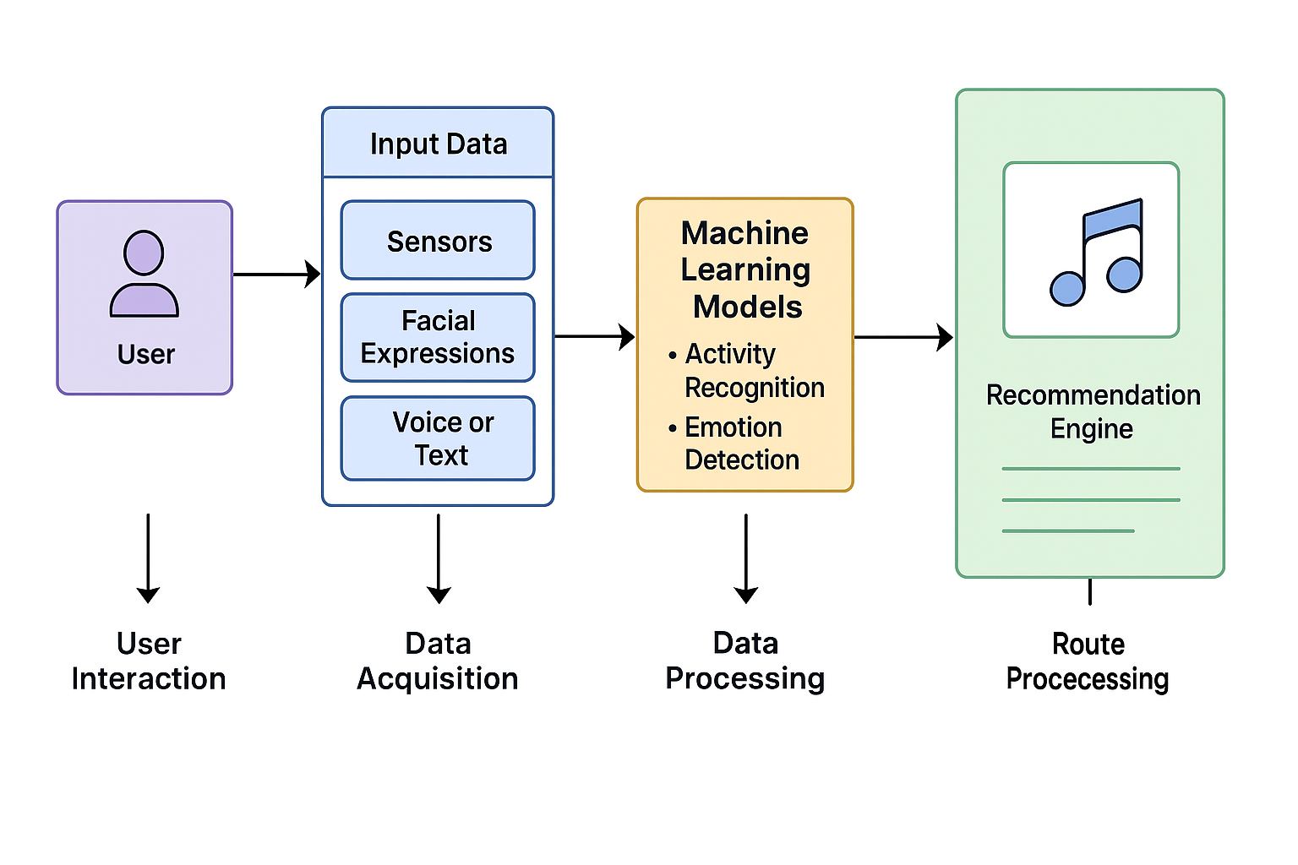
Architecture

Slide 15

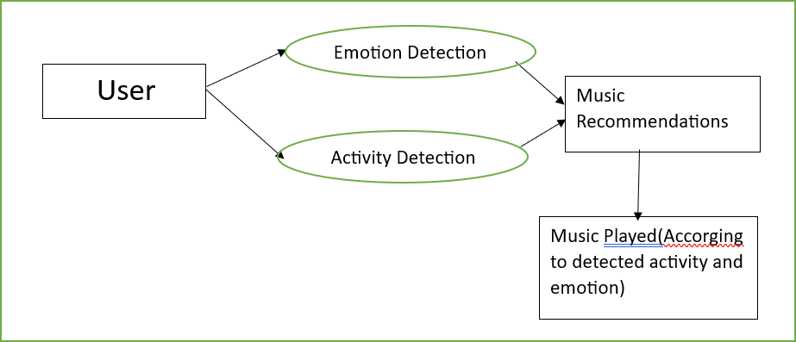
DATA FLOW DIAGRAM
Data Flow Diagram (0)
Data Flow Diagram (1)

Slide 16
Modules
Session Detection (session):
This module checks the time of the day (morning, night, etc.) to identify the session in which the user is using the application. It helps personalize the song recommendation based on the time of day and the user's typical habits during that session.
Physical Activity Detection (Pact):
This module tracks the user's physical activity, such as walking, driving, or cooking. It influences the song recommendation by tailoring it to the user’s physical context, ensuring the music matches their level of movement.

Slide 17
Emotion Detection:
After emotion detection by the ML module, the classified emotion is sent back to the model. This data helps in choosing music that aligns with the user's current emotional state.
Data Processing, Training, and Classification:
The system collects data inputs (such as session, mobile activity, physical activity, and emotions), processes them, and applies a trained machine learning model to classify these inputs. It predicts a suitable song based on these factors.
Predicted Song Output:
The final output is the prediction of a song that matches the user's current emotional state, mobile activity, physical activity, and session. The predicted song is sent to the Android smartphone for the user to play.

Slide 18

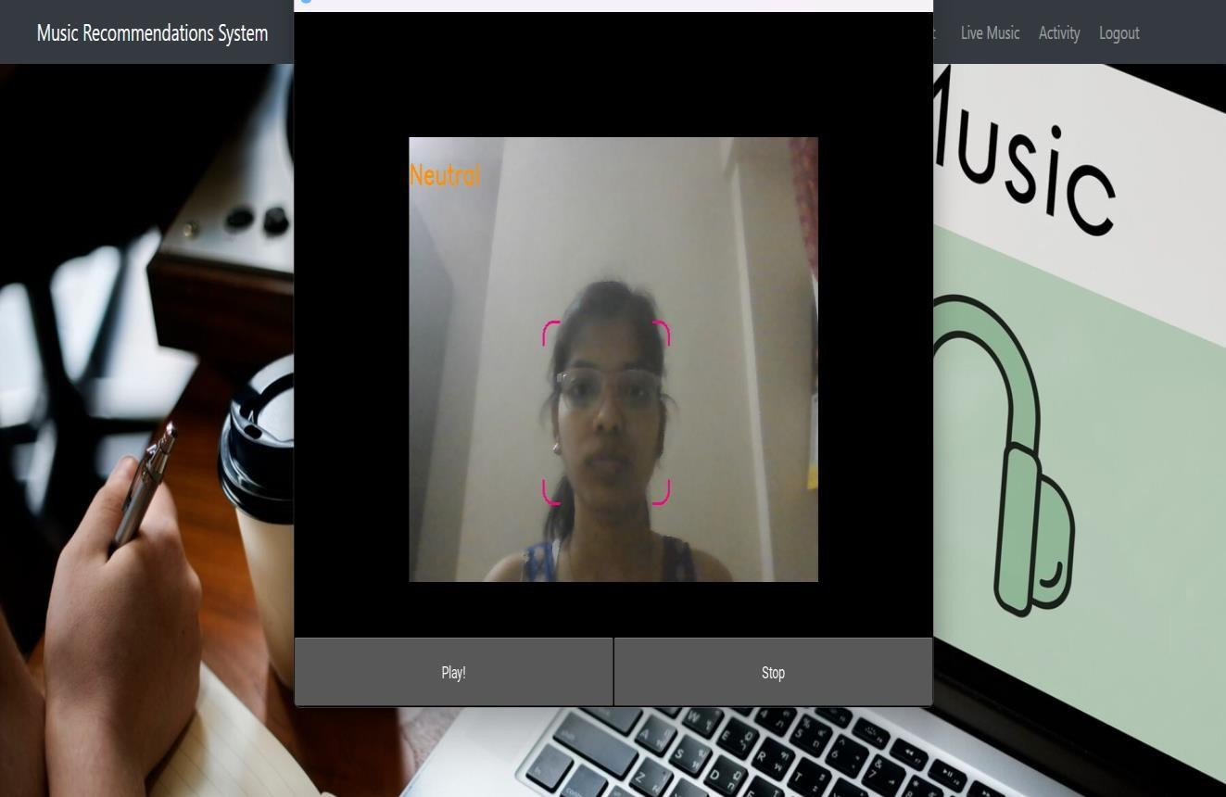
System Output
Home Screen
Emotion Detection

Slide 19

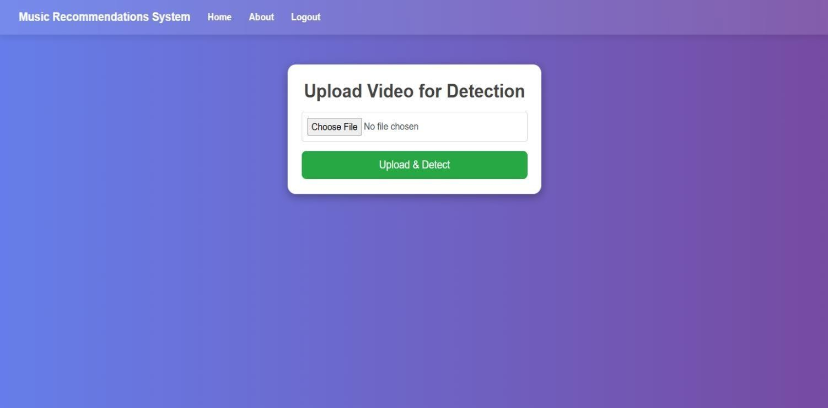
Emotion Detection
Activity Detection

Slide 20
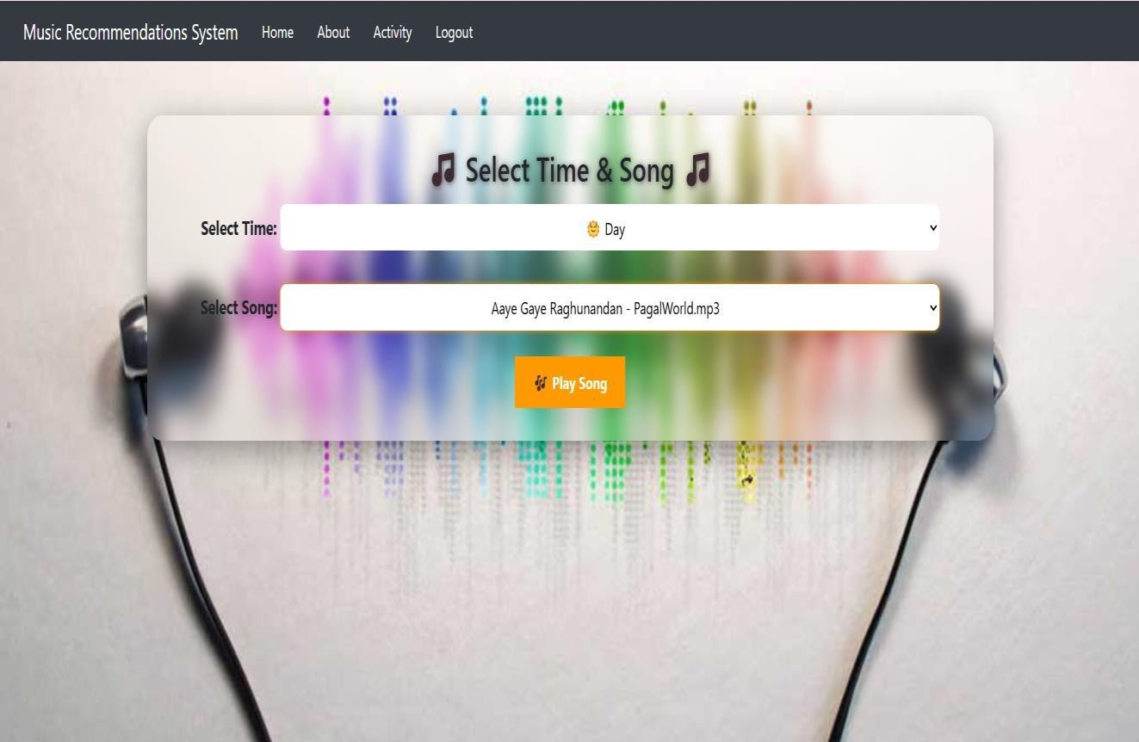
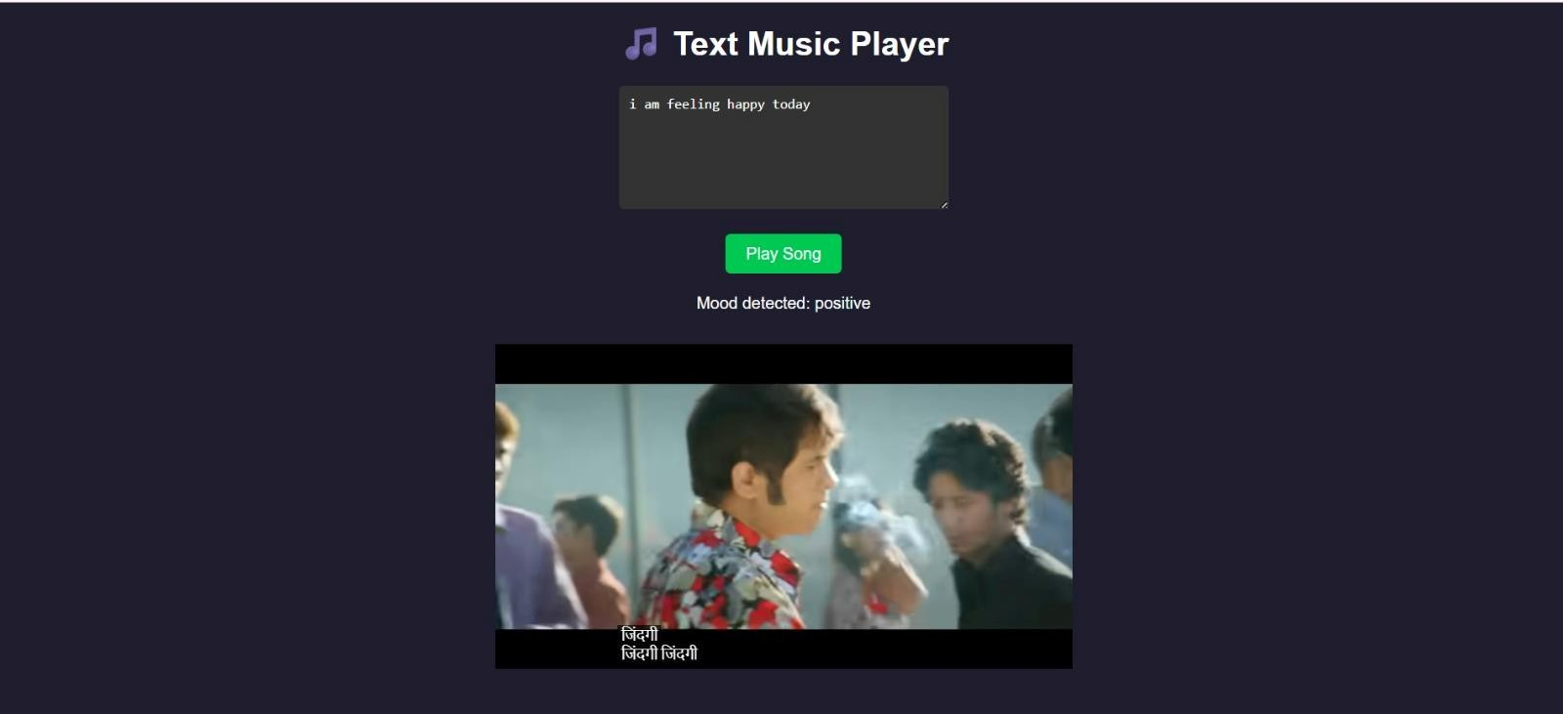
Day and Night Music Detection
Text Recommendation

Slide 21
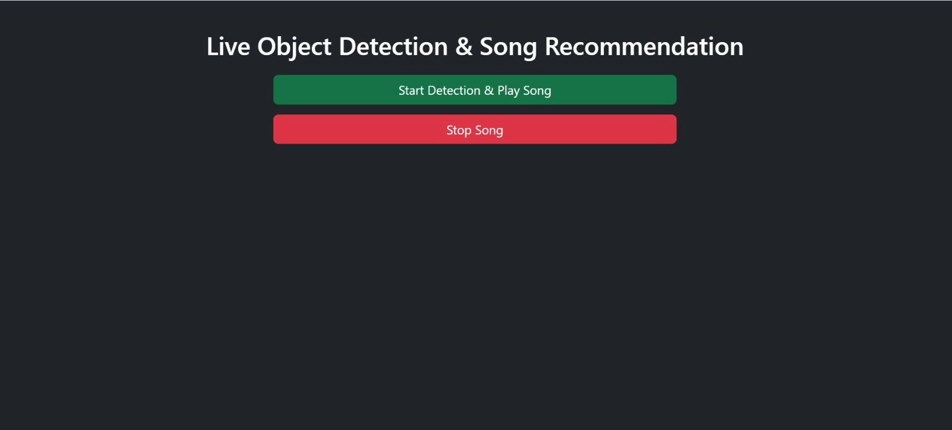
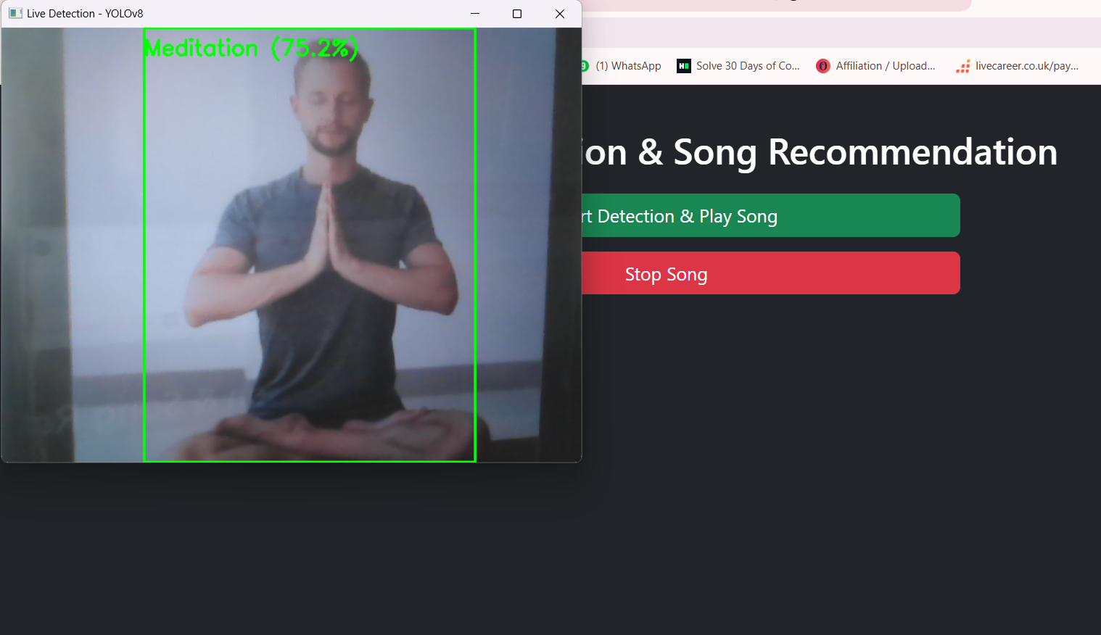
Live Activity Detection
Activity example

Slide 22
Advantage
Personalized Music – Music matches your mood and activity (happy, sad, workout, etc.).
Mood Boosting – Helps improve or calm your mood with the right songs.
More Engaging – Keeps you interested by playing music that fits your current situation.
Better Focus – Plays music that helps with tasks like working, studying, or exercising.
Automatic Playlists – Songs change based on how you feel and what you're doing.

Slide 23
Disadvantage
Internet Required – Limited offline use.

Slide 24
Conclusion
In conclusion, the real-time emotion-based music player project successfully utilizes deep learning techniques to detect facial emotions in real-time and recommend songs or playlists based on the detected emotions.
The integration of Flask, cv2 (OpenCV), and text classifier components enables a seamless user experience and accurate emotion classification.
The project demonstrates the potential of combining computer vision, natural language processing, and web development to create an interactive and personalized music player
The Emotion and Activity-Based Music Player combines artificial intelligence with human-centered design to create a personalized and immersive music experience. By understanding the user's emotions and activities, the system intelligently recommends music that enhances mood, focus, or relaxation. This project not only demonstrates the power of context-aware technology but also opens doors to more emotionally responsive applications in everyday life.

Slide 25
References
Abhishek R. Patel, Anusha Vollal, Pradnyesh B. Kadam, Shikha Yadav, Rahul M. Samant. MoodyPlayer: A Mood based Music Player. International Journal of Computer Applications (0975 8887) Volume 141 No.4, 2016.
Arya Joshi, Dnyaneshwari Dhumal, Akanksha Ghadge, Abhimanyu Giri, Prof. Balaji Chaugule:A Research Proposal for the Emotion And Activity Based Music Player Using Machine Learning
Namrata Mahajan, Harshad Mahajan. Detecting Emotion in Music. International Journal of Electrical and Electronics Research ISSN 2348- 6988 (Vol. 2), Issue 2, pp: (56-60), Month: April - June 2014.
Day, Mattew. Emotion recognition with boosted tree classifier. 2013 ACM international conference on Multimodal Interaction
Human Facial Expressions [Image]. Retrieved on October 9 2012 from http://www.flickr.com/groups/1876998@N24 /pool/.

